Slide 1
Implementation of MD5 Algorithm
Muhammad Naufal P.P
Ugi Ispoyo Widodo

Slide 2
What we Discuss?
MD5 Algorithm
Implementation of MD5 Algorithm
How to works of MD5 Algorithm
Advantages and Disadvantages

Slide 3
Background
High human needs to the future require people to continue developing the technology owned. Human create solutions to overcome many problems, and now appears an algorithm used for security hash, one of them is MD5 algorithm.

Slide 4
History of MD5 Algorithm
In 1990, Ron Rivest invented the hash function MD4.
In 1992, he improved on MD4 and developed another hash function: MD5.

Slide 5
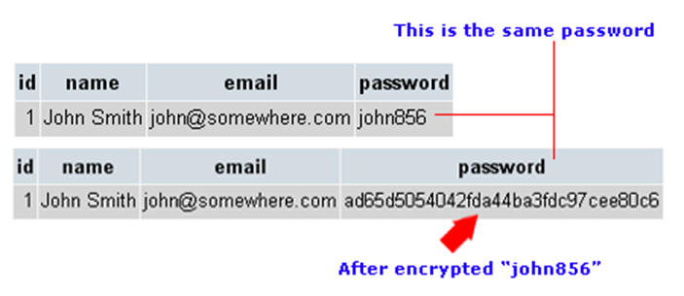
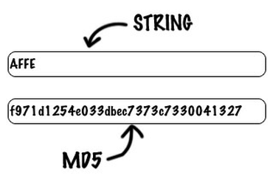
What is MD5 Algorithm?
MD5 processes is a variable length message into a fixed length output of 128 bits. The input message is broken up into chunks of 512 bit blocks.

Slide 6
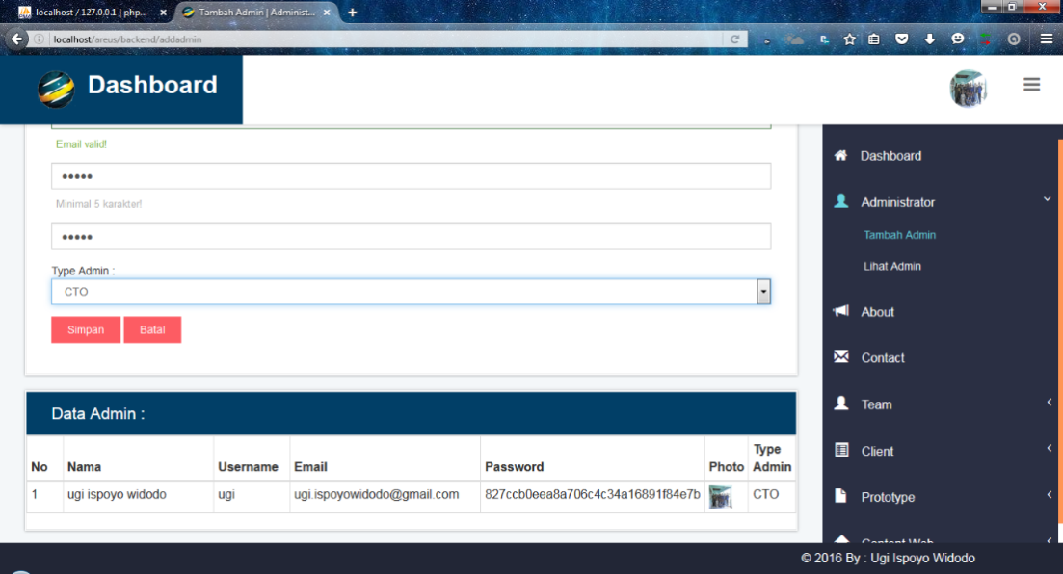
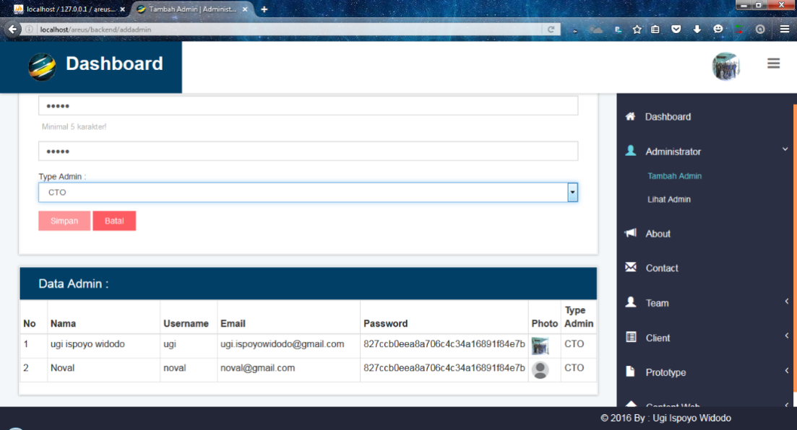
Implementation of MD5 Algorithm

Slide 7
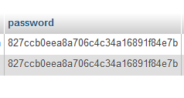
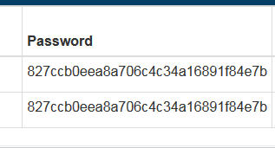
Implementation of MD5 Algorithm

Slide 8
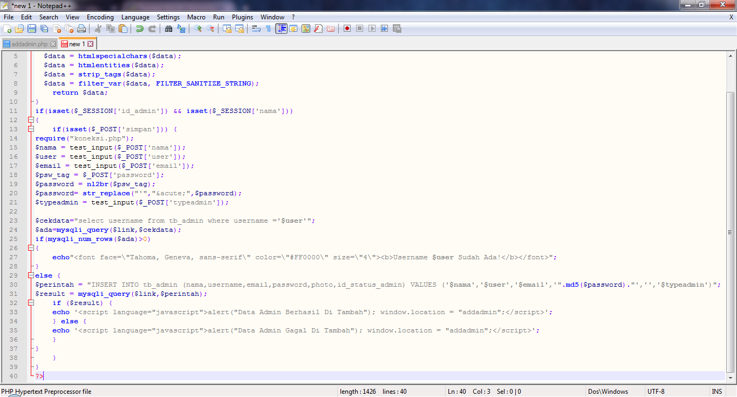
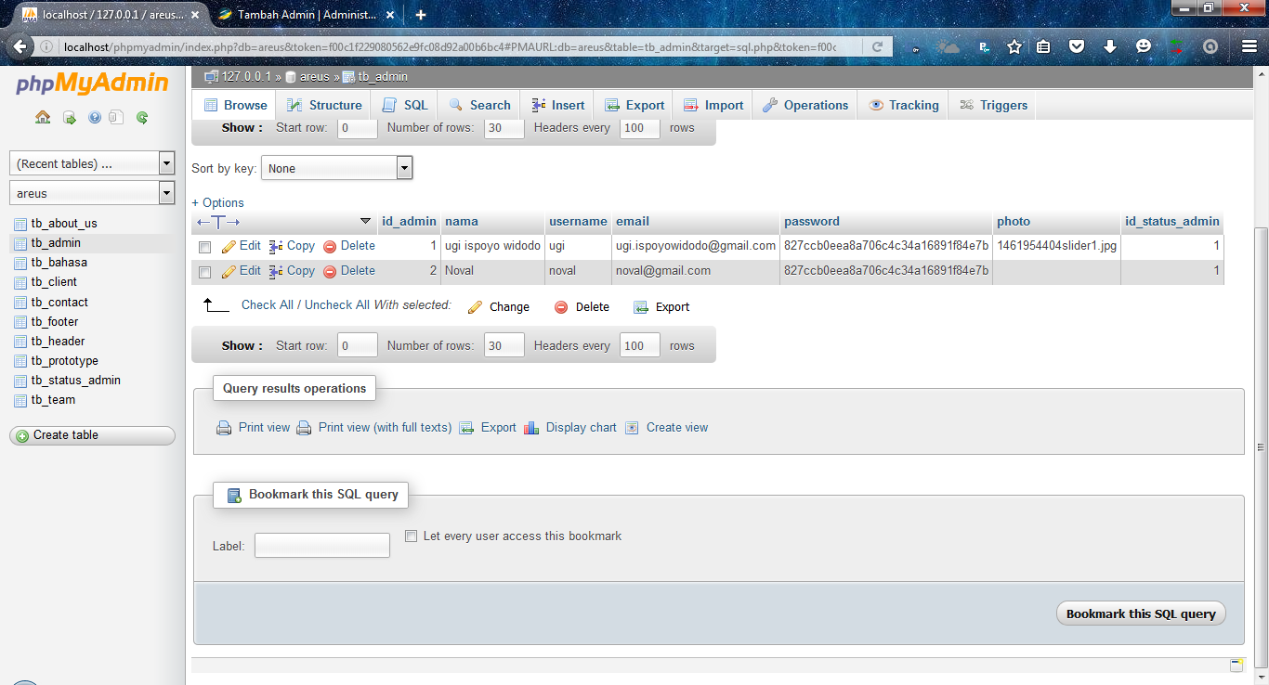
Implementation of MD5 Algorithm

Slide 9
Implementation of MD5 Algorithm

Slide 10
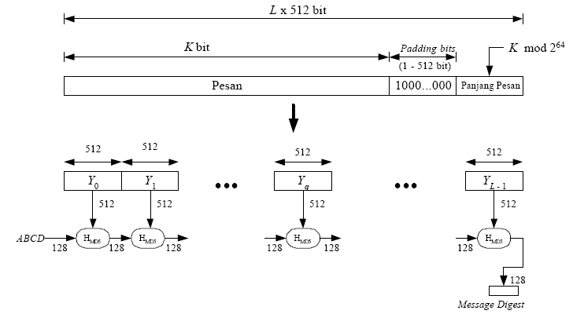
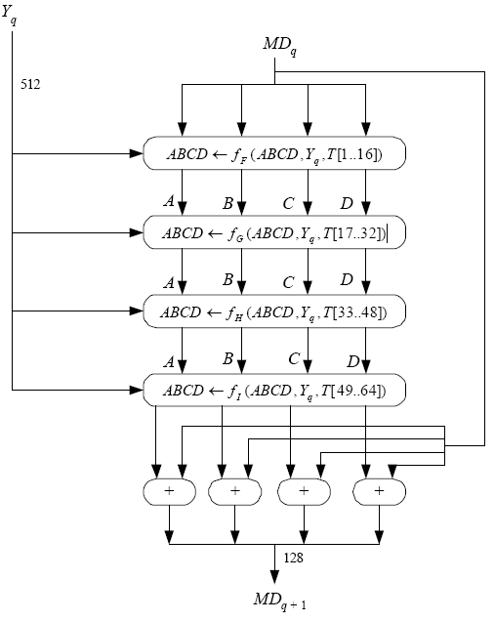
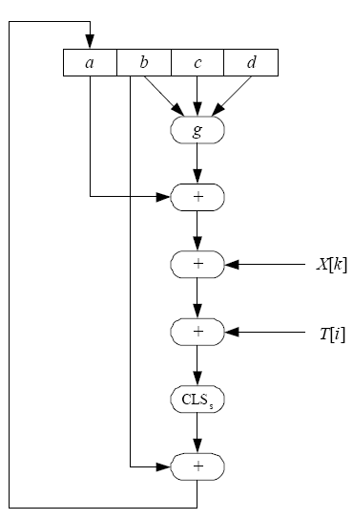
How to Work of MD5 Algorithm
Appending Padding Bits
Appending Length
Buffer Initialization
Processing of the Message
Output
The following diagram is a diagram of the whole process of the MD5 algorithm. The arrow diagrams explaining the smaller stages.

Slide 11
Disadvantages of MD5 Algorithm
Advantages of MD5 Algorithm
Fast Computation Algorithm
Widespread Used
Provides Collision Resistance
Provide a One Way Hash
Security Flaws and Vulnerability
Less Secure than SHA-1 Security

Slide 12
Conclusion
The MD5 message-digest algorithm is simple to implement, and provides a security for data
Suggestion
In the use of MD5 Algorithm we must have a basic knowledge of internet, coding, and security manage. So, we will not have problems in relation interface to come. While the technology can prove to be a great asset, it could also cause harm if not understood and used properly.

Slide 13
Thanks For Your Attention...
Implementation of MD5 Algorithm

